Slide 1


Artificial Intelligence in the Mathematics Classroom
Challenges and Opportunities
Sandra Nobre, Universidade do Algarve
12 de setembro de 2025

Slide 2
🎯Session Objectives
▪To reflect on the potential of AI in the teaching and learning of Mathematics
▪ To explore practical tools for teaching
▪ To identify risks, limitations, and best practices

Slide 3
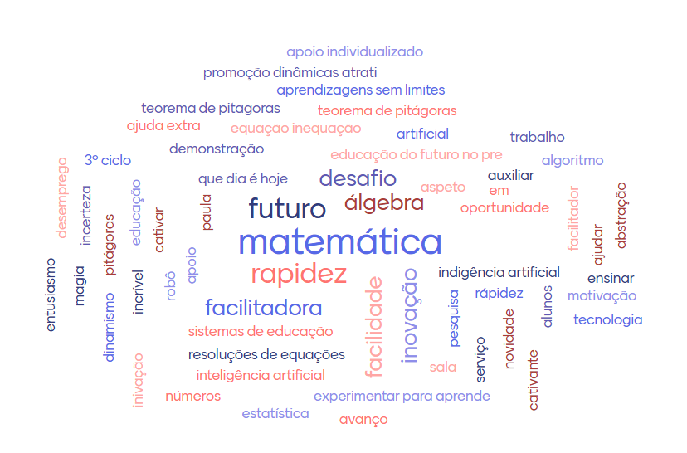
Artificial Intelligence at the Service of Education

Slide 4
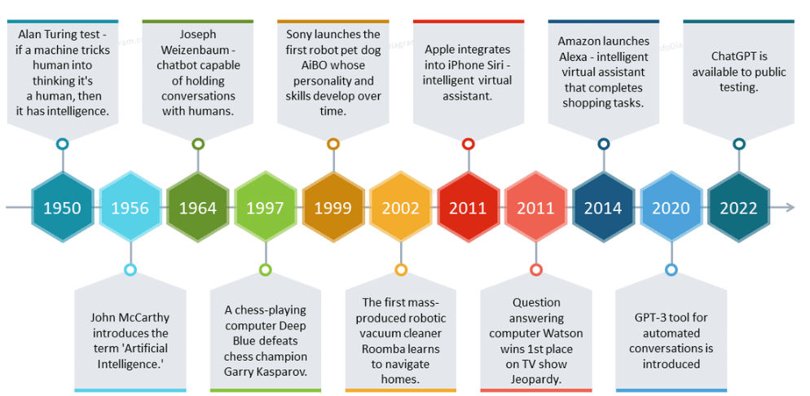
Artificial Intelligence - Historical Evolution
https://www.infodiagram.com/pt/diagrams/modelo-ppt-de-diagramas-de-ia-e-aprendizado-de-maquina/#slide_8

Slide 5
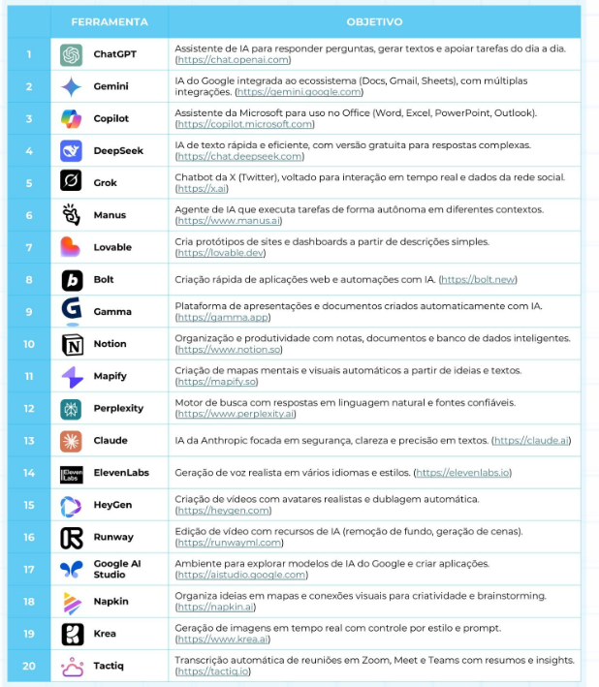


Some Artificial Intelligence Tools
https://www.instagram.com/p/DN5TilLiJdr/?igsh=YXp1YmJxemNjMWN6

Slide 6
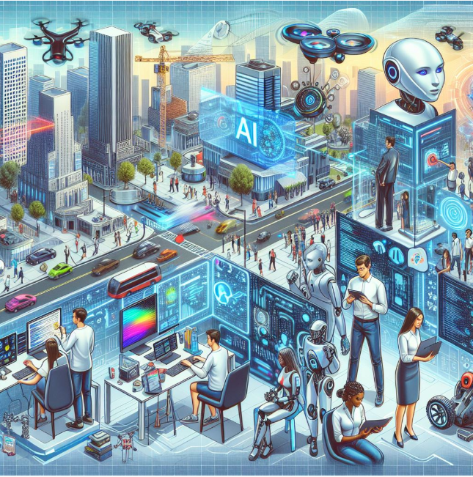
A "prompt" is an instruction, question, or text that serves as a stimulus for an artificial intelligence (AI) system to generate a specific output, such as text, images, or code.
Prompt

Slide 7
Some Prompt Techniques
TAO Method – Task, Action, Outcome (or Objective)
PAR Method – Problem, Action, Response
PACE Method – Persona, Action, Context, Expectation
P (Persona): State how the AI should behave.
Example: "Assume the role of a Mathematics teacher."
A (Action): Specify what the AI should do.
Example: "I need to create a 50-minute lesson plan."
C (Context): Provide the necessary context.
Example: "...for a 7th-grade class that is about to start studying sequences and regularities. The class has 25 students, two students have significant learning difficulties, and 3 students only speak English."
E (Expectation): Define the expected outcome.
Example: "Create a detailed lesson plan that includes pedagogical differentiation.”

Slide 8
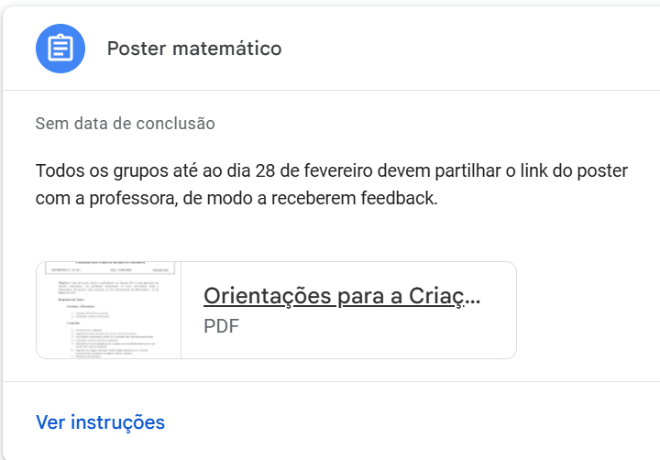
AI in the Classroom – Sharing Experience
Mathematical Poster – Guidelines for Students

Slide 9
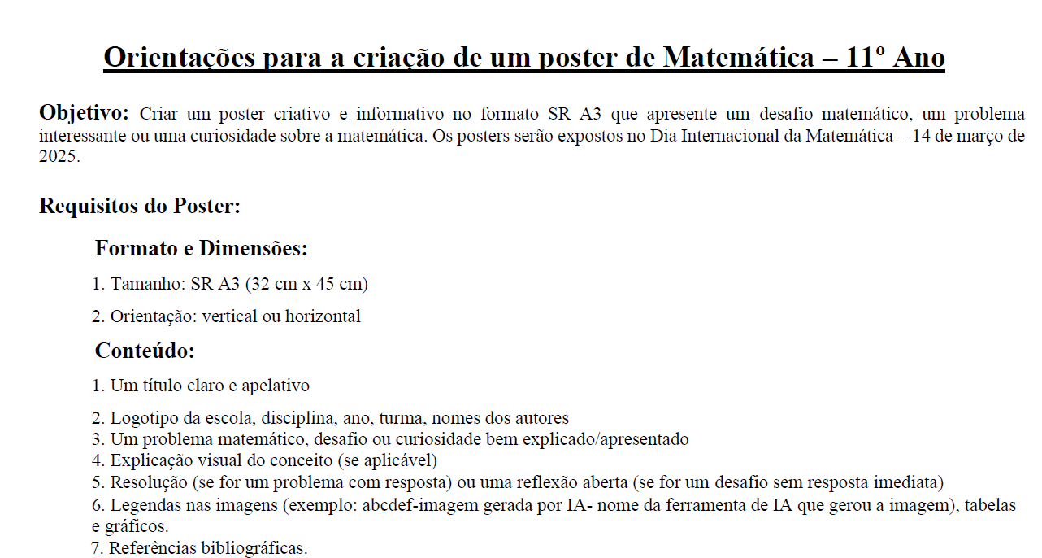
AI in the Classroom – Sharing Experience
Mathematical Poster – Guidelines for Students

Slide 10
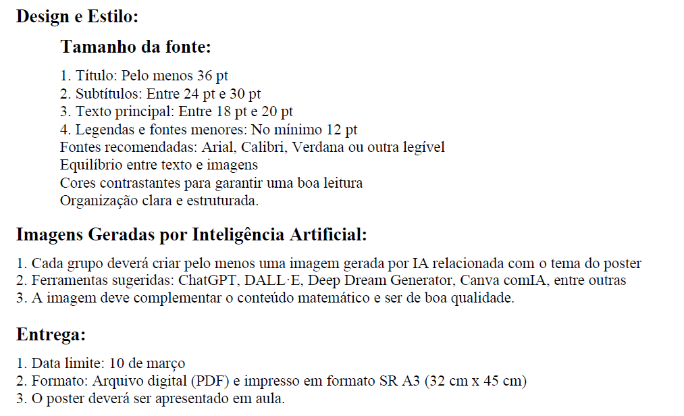
AI in the Classroom – Sharing Experience
Mathematical Poster – Guidelines for Students

Slide 11
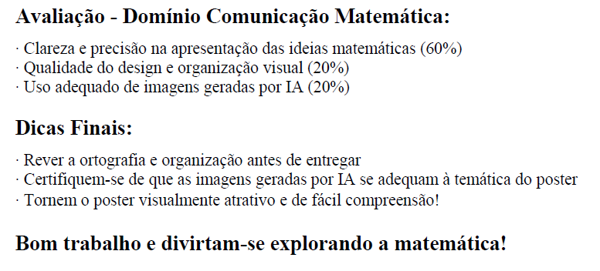
AI in the Classroom – Sharing Experience
Mathematical Poster – Guidelines for Students

Slide 12
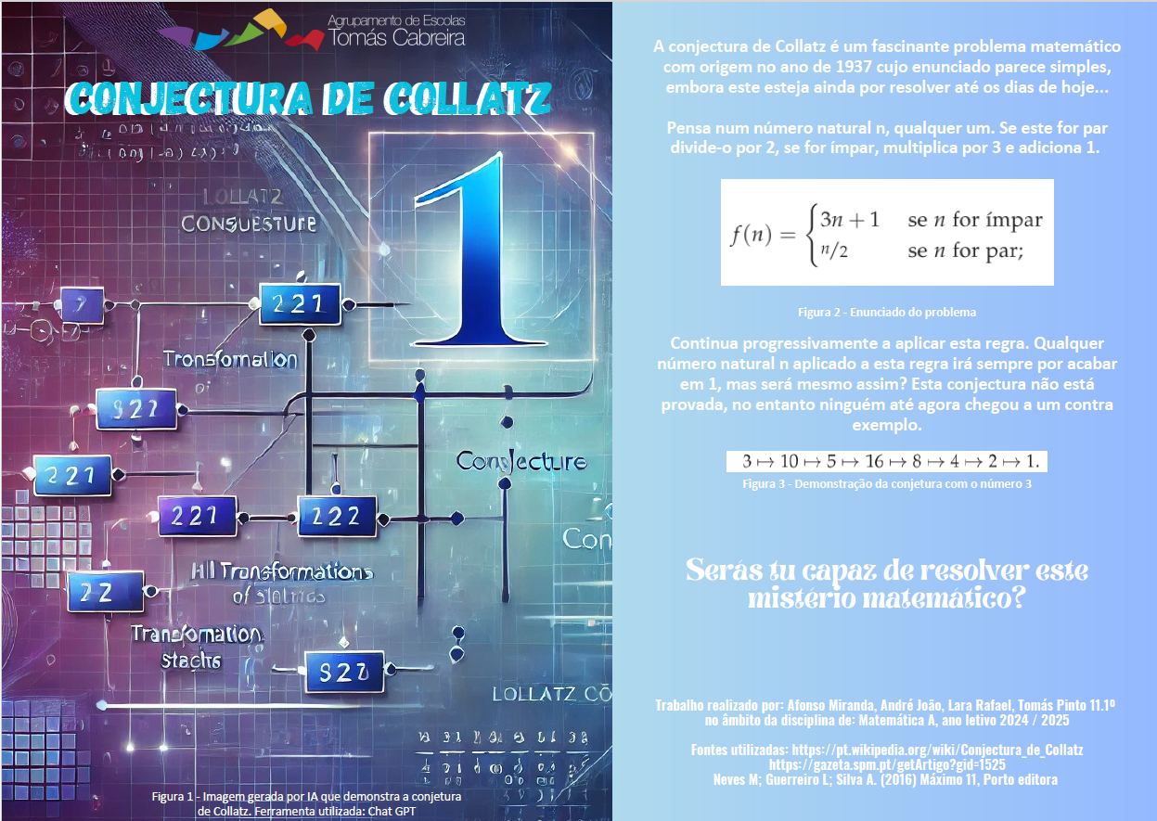

Slide 13
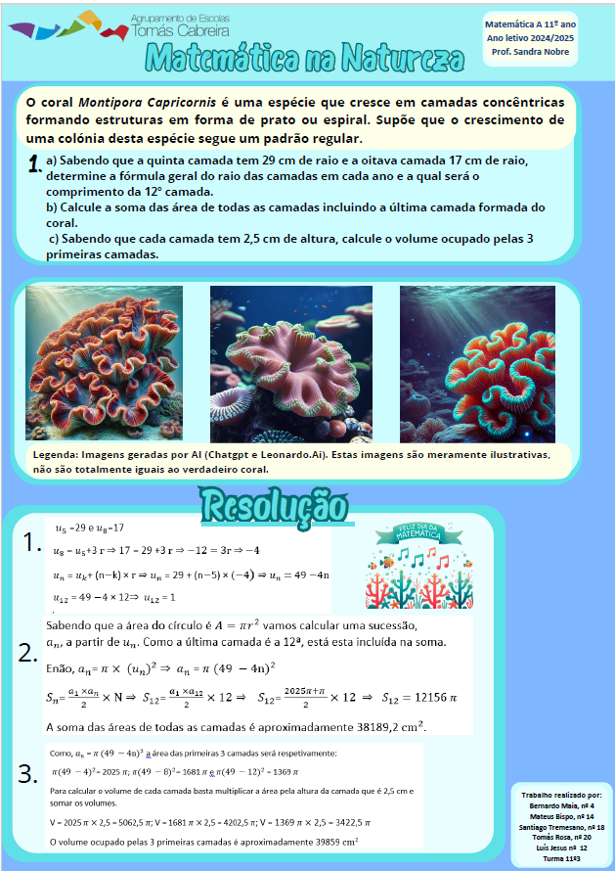

Slide 14
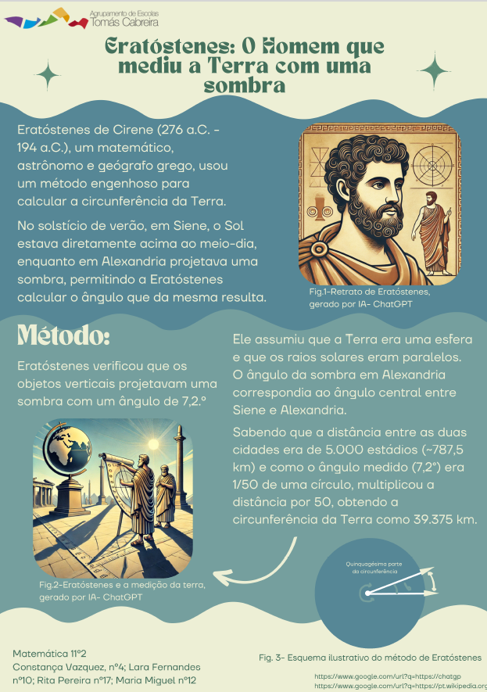

Slide 15
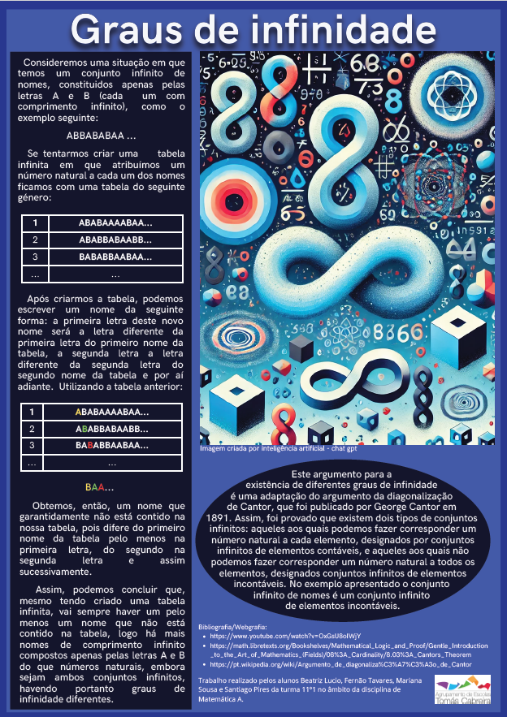

Slide 16
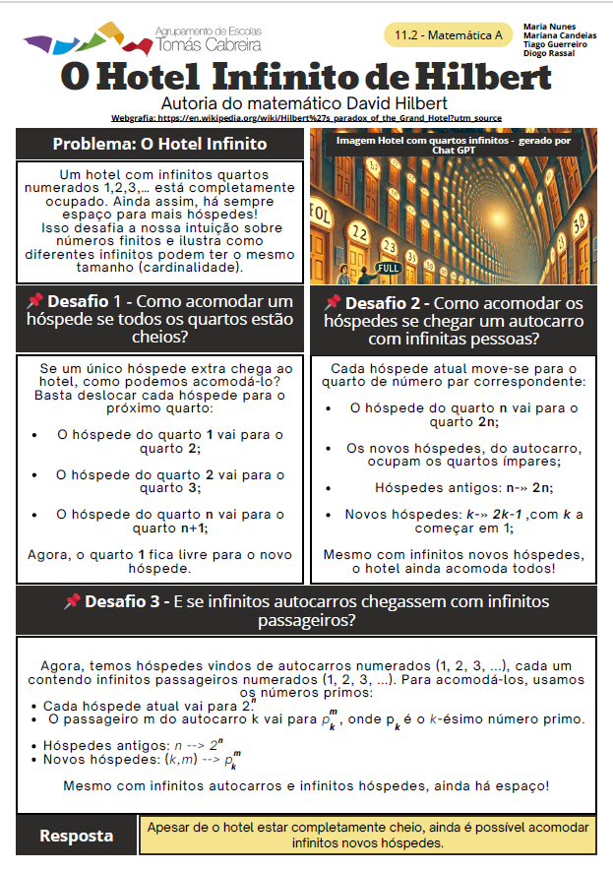

Slide 17
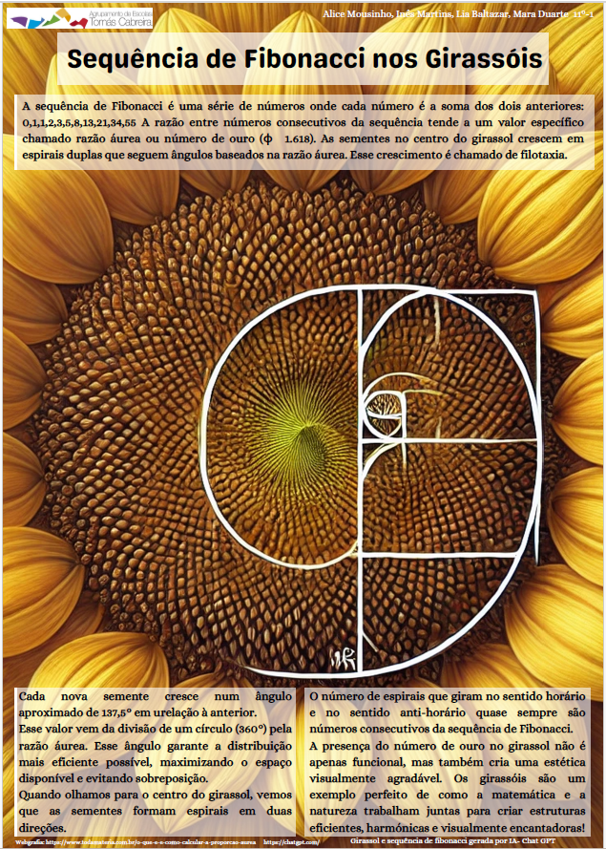

Slide 18
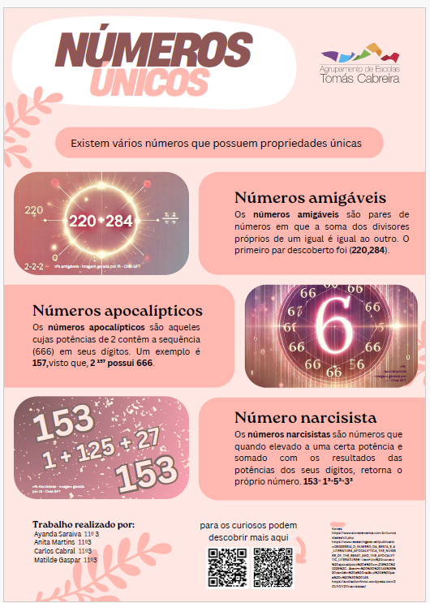

Slide 19
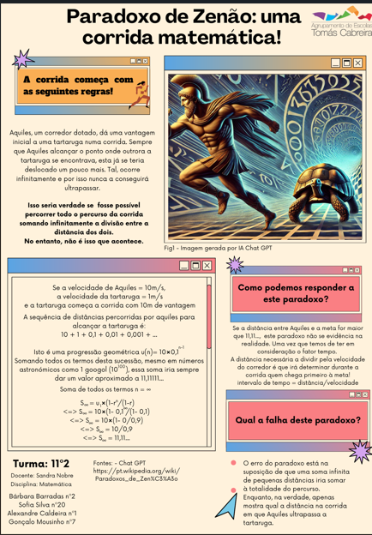

Slide 20
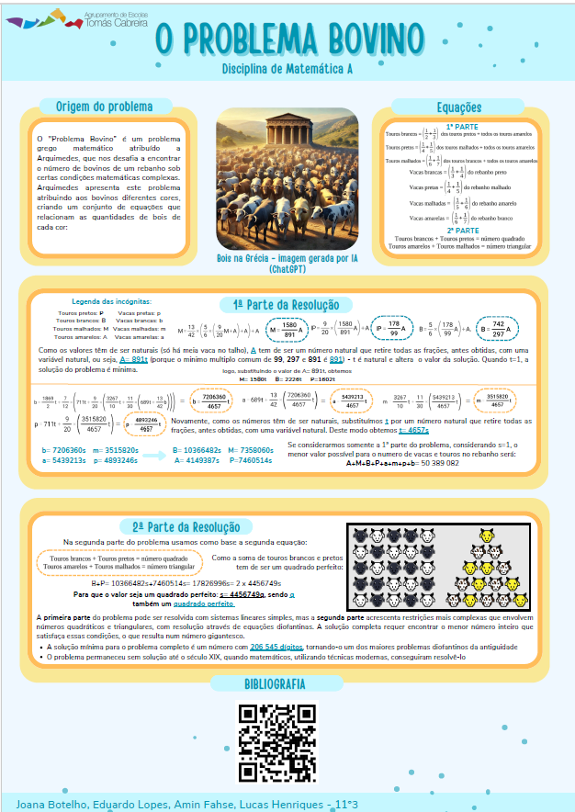

Slide 21
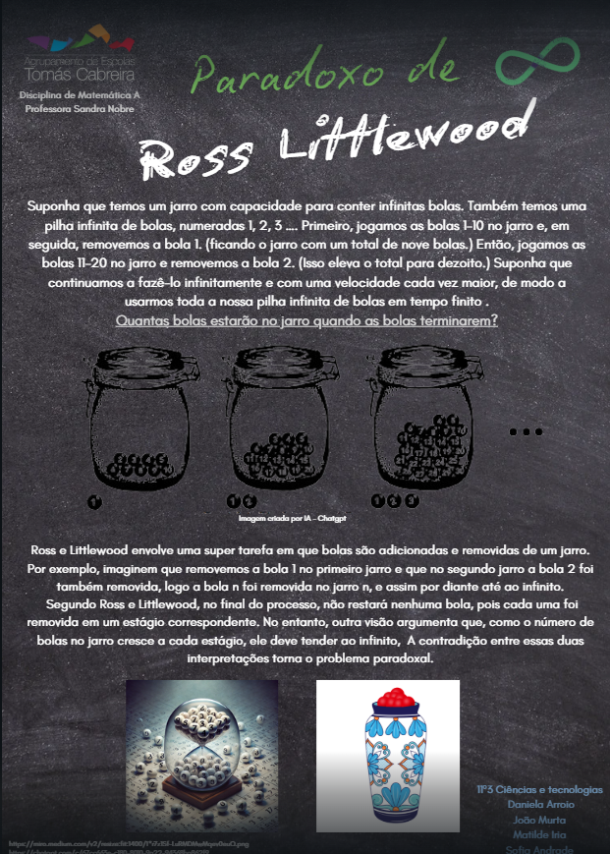

Slide 22

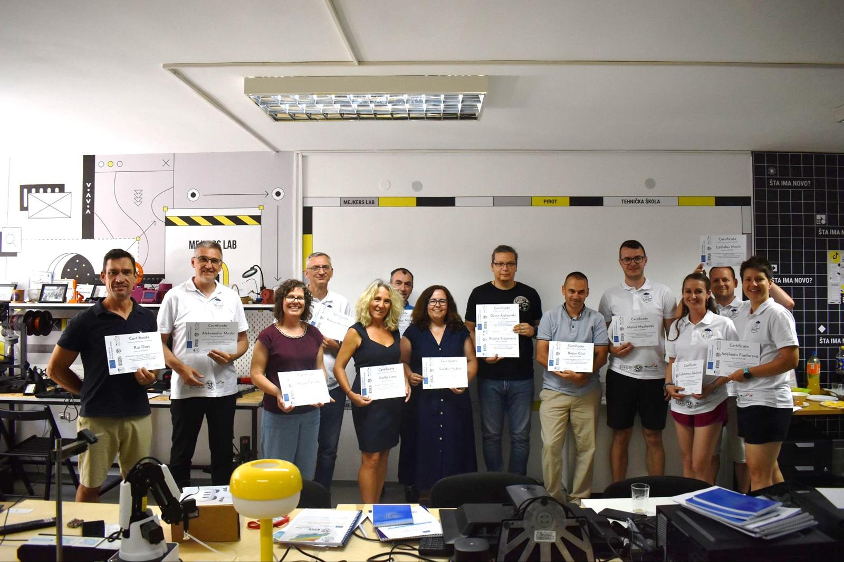
Erasmus+ Project
Portugal AETC
Sérvia Escola técnica
Eslováquia ICEP

Slide 23
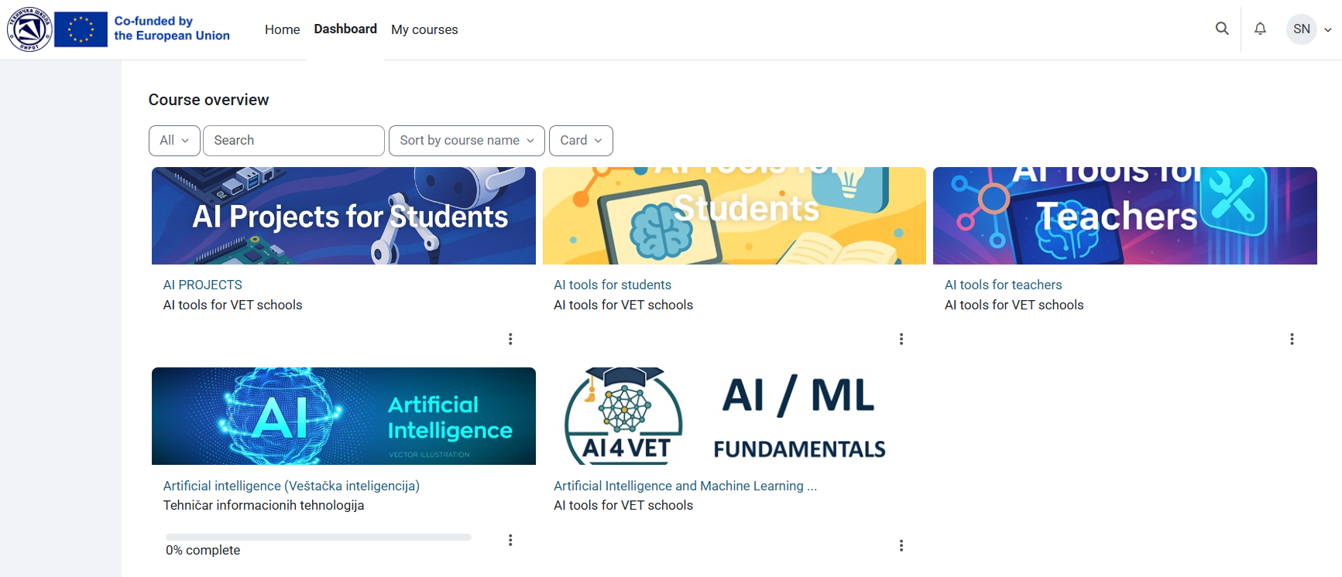
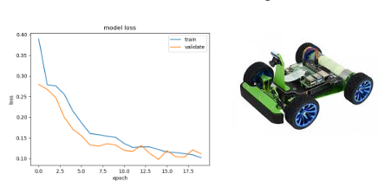
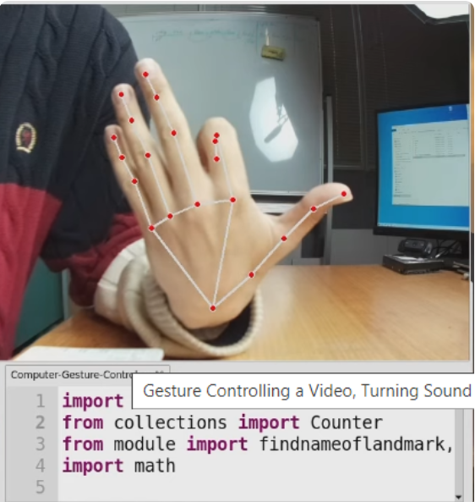
Erasmus+ Project

Slide 24
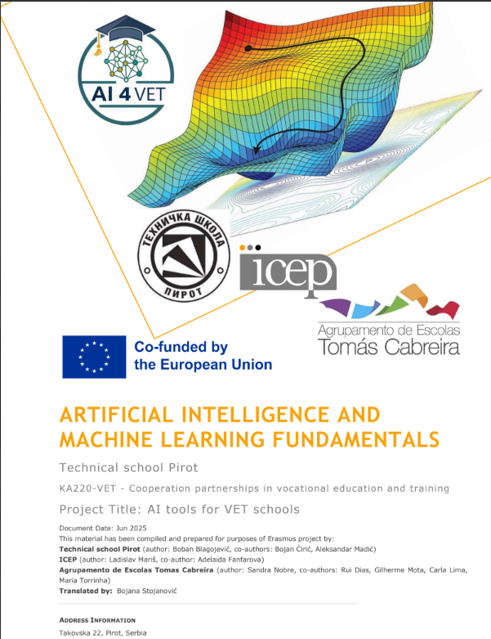
Erasmus+ Project
Book Theory IA and ML
Book for teachers
Platform for students

Slide 25
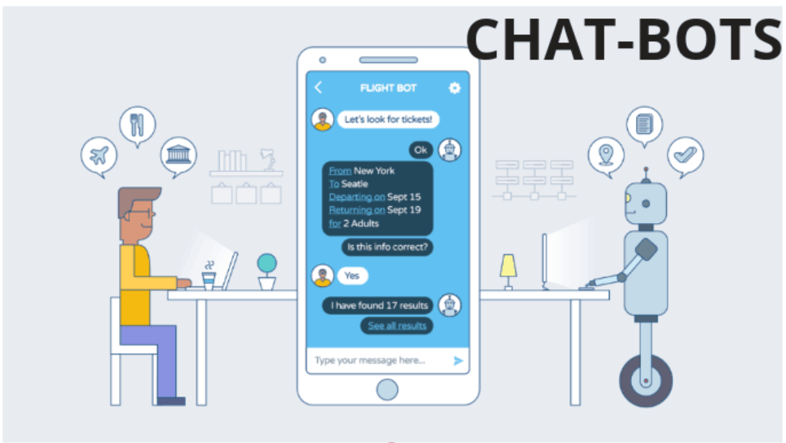
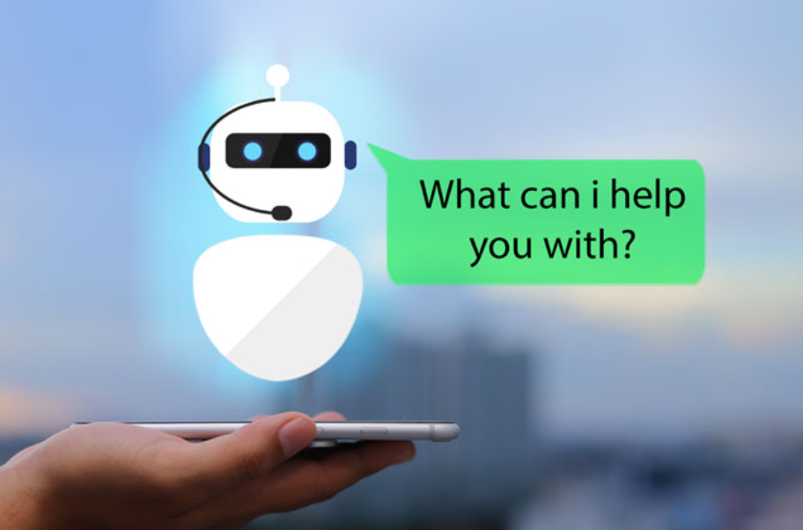
A chatbot is a software that simulates human conversations, using AI to interact with users via text or voice, answering questions and performing tasks.
Chatbot

Slide 26

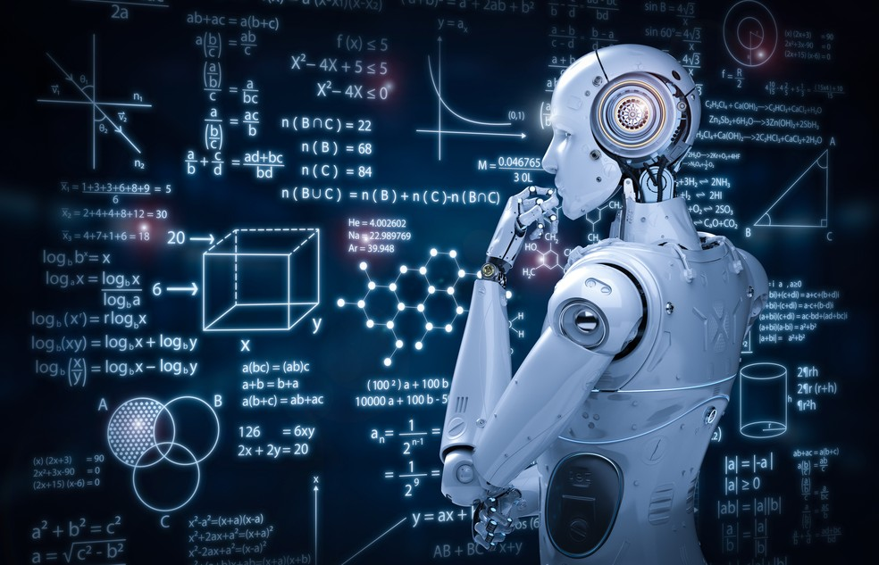






Chatbots in Teaching

Slide 27
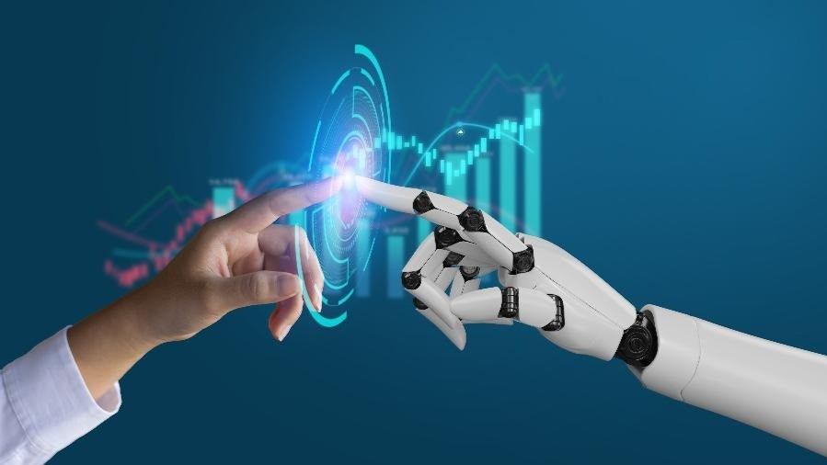
📝 Action Plan (1 – 3 – 7)
1 idea to implement tomorrow
3 ideas to implement within a week
7 ideas to implement within a term/semester

Slide 28
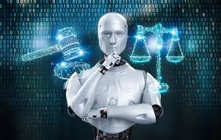
⚖️ Guiding Principles
▪ Pedagogical intentionality
▪ Transparency and ethics
▪ Verification and validation
▪ Data protection (GDPR)
▪ Equity and inclusion

Slide 29

💬 Critical Debate
▪ Opportunities: motivation, differentiation, efficiency
▪ Challenges: reliability, ethics, privacy, dependence
▪ How to guarantee the irreplaceable role of the teacher?

Slide 30
Final Message
AI amplifies the creativity of students and teachers, but it never replaces the pedagogical autonomy of the teacher.
Thank you for your participation!
sgnobre@ualg.pt

Slide 31
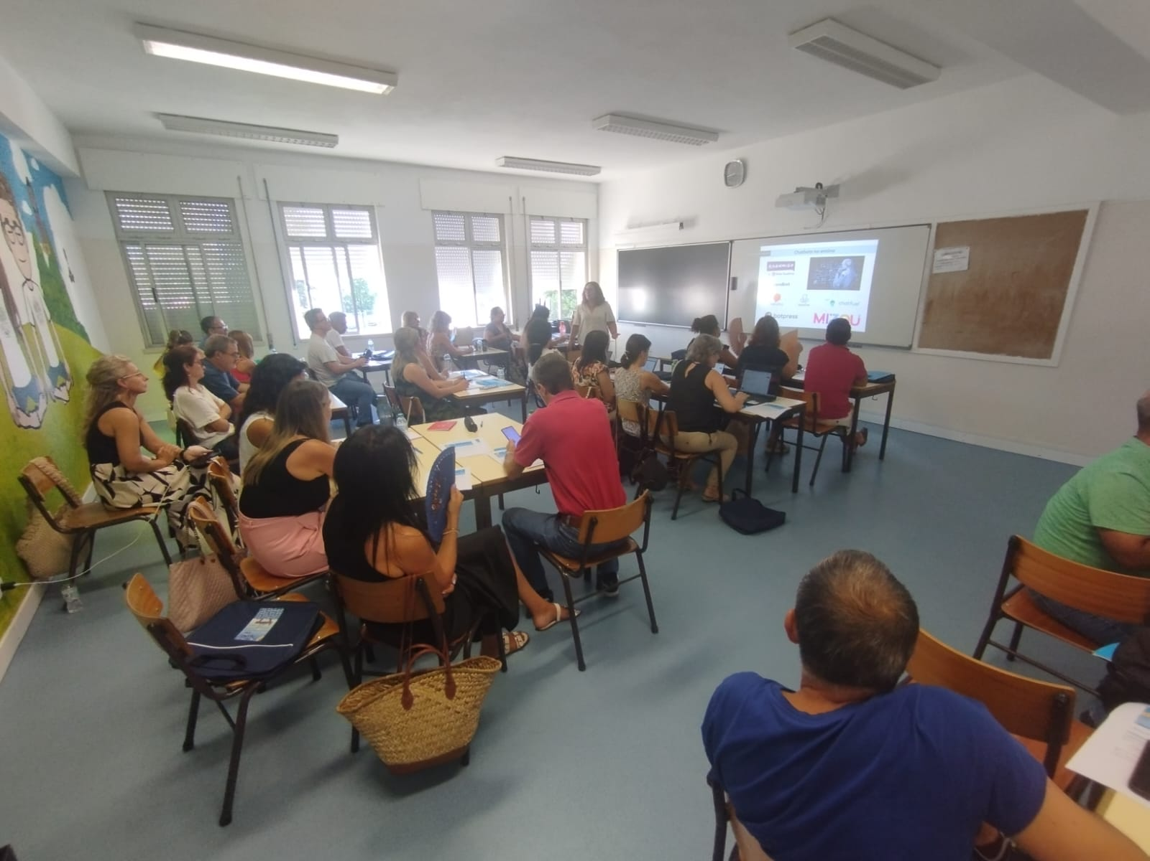

Slide 32
