Slide 1



AIVET - AI tools for VET schools

Slide 2


About the project aivet
Erasmus+ project 2024-1-RS01-KA220-VET-000254863
01.09.2024 – 31.08.2026
Tehnička škola – Serbia (leader)
Agrupamento de Escolas Tomás Cabreira - Portugal
ICEP - Slovakia

Slide 3
About the project aivet
With this project we want to achieve two things:
1. to improve the competences of teaching, but also non-teaching staff, in field of basic usage of AI;
2. to create a material for AI teachers in VET schools, which would help them in AI theory, practice, when working with AI equipment but also, with publicly available AI tools. All this material will be publicly available and presented via the LMS (Learning Management System) platform open for all users.

Slide 4



Slide 5
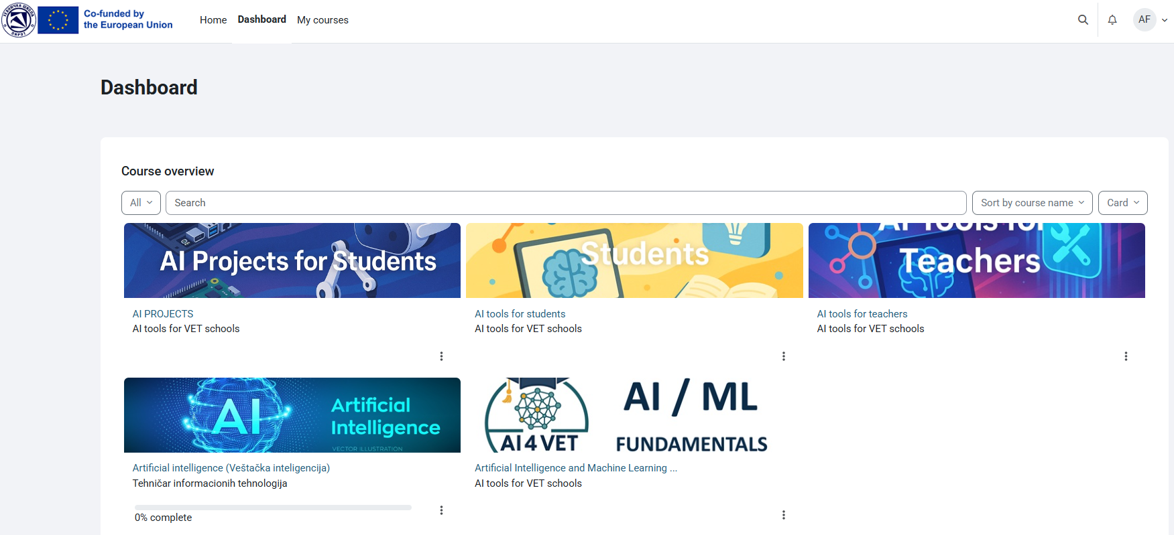

Slide 6


Otázky?
ladislav.maris@uniza.sk
adelaida.fanfarova@iceponline.com

